Slide 1
Changing Minds
Using the Rhetorical Appeals in Persuasive Arguments

Slide 2
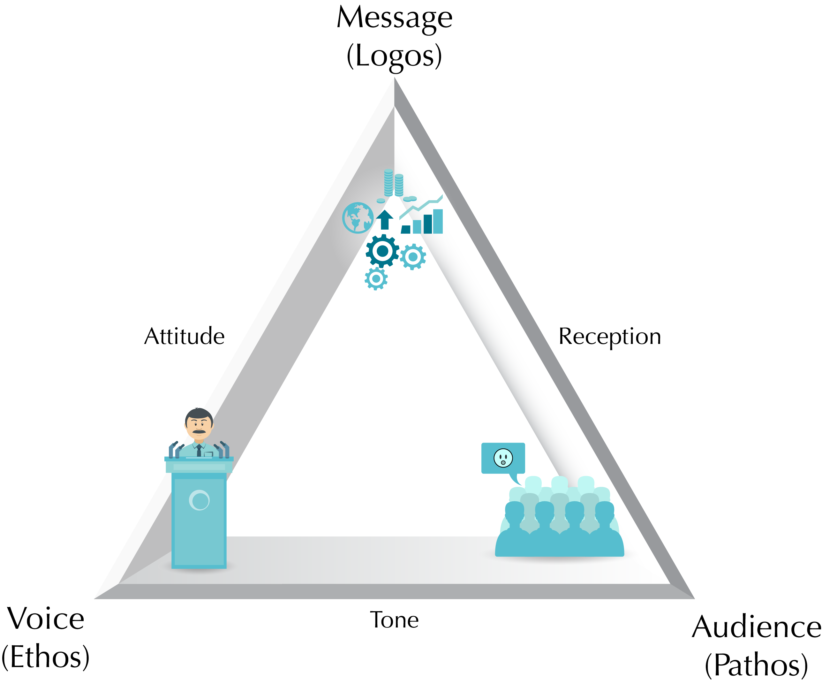
The Rhetorical Triangle and 4 Appeals
ETHOS
PATHOS
LOGOS
KAIROS

Slide 3
The McDonalds Hot Coffee Lawsuit

Slide 4
Using the Appeals
Ethos
Pathos
Logos
Who is responsible?
For whom do we feel empathy?
Just the facts

Slide 5
ETHOS - ETHICAL
People
PATHOS - PATHETIC
Emotions?
LOGOS - LOGIC
Info about the product
Music and Sound
Colors
Set / Cast
Celebrity
Logo
Logo

Slide 6
This advertisement for Chef Boyardee employs some of the rhetorical devices. It presents the notion of ethos through the fact that the child obviously enjoys eating the food. Children are generally thought to be picky eaters, a commonplace worth mentioning. The little boy’s smile proves that Chef Boyardee is delicious, and that it’s a favorite among children, in addition to being cheap. It also presents ethos through the small lettering in the bottom right hand corner. It reads, “Found in Mom’s Basement”. Another common belief is that a mother’s cooking is the best cooking. Because they are making it seem as though mother’s have given their endorsement to this product, they are justifying their credibility as a food brand. The smile can also be considered a work of pathos; who doesn’t like to see a child smiling? It plays on the emotions of the viewers.

